Slide 1
CHAMACOS Community Forum

Slide 2
Today’s Schedule
6:15-6:20- Welcome
6:20-6:40- New CHAMACOS research:
Pesticide use and children’s development
Do social challenges make pesticides worse?
Pesticides and weight gain
6:40-6:50- The COSECHA Study
6:50-7:05- Pesticide Use Map Overview
7:05-7:25- Lawyer Presentation
7:25-7:30- RAFFLE!
7:30-8:00- One on one talks

Slide 3
Pesticide use and child development:
Most of our work today is about one group of pesticides known as organophosphates, often called “OPs”. We studied these pesticides because they may affect developing children.

Slide 5
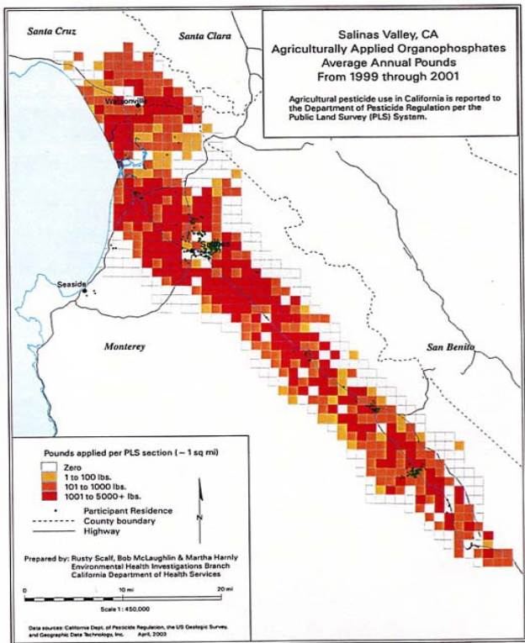
Areas of Highest OP Use

Slide 6
How much pesticides are used near homes?
Notes:
Previous studies have approximated use based on area within buffer around home. In this example, the buffer radius is 1,000 meters. Total Mn-fungicide use during prenatal period was 1,200 kg, but adjusting for proportion of area within 1,000 meters the amount is 83 kg.

Slide 7
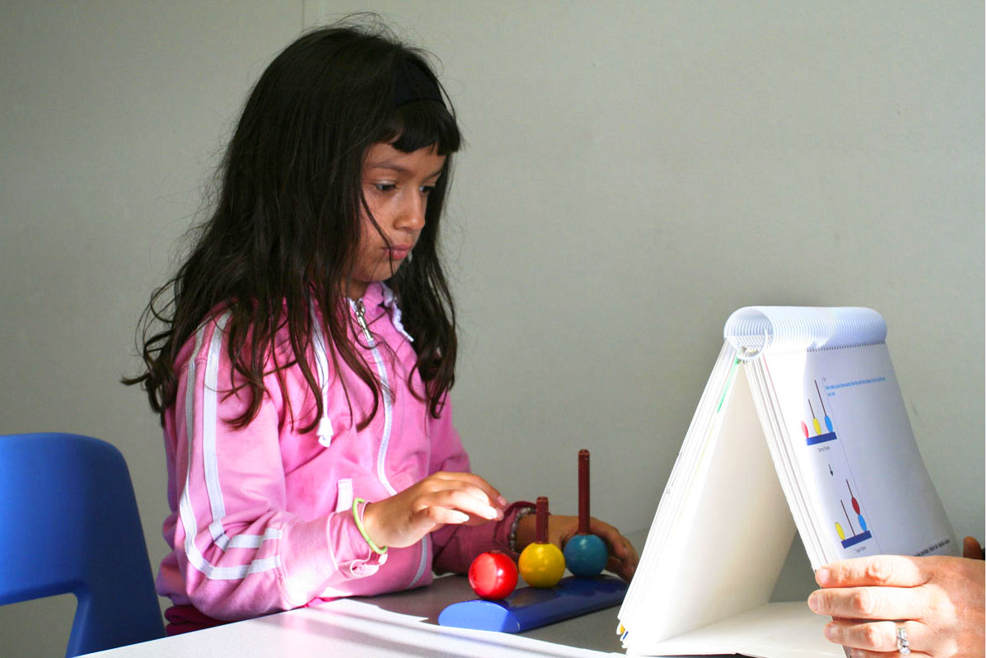
Is nearby OP use related to children’s development?

Slide 8
Nearby OP Use and Child Development
When more OPs were used near homes during pregnancy, children had lower development scores at 7 years.
This is similar to what we saw when there were higher levels of OPs in urine.
We think measures in urine most likely come from pesticides on food and less from pesticide drift. Using maps, we are better able to see that living near where pesticides are used may increase exposure from drift.
Notes:
Development here is measured by IQ Points

Slide 9
Higher use of some fumigants, (ex. methyl bromide and chloropicrin), also associated with slightly lower development scores.
Like OPs, methyl bromide at high levels can be bad for children’s brains. We are working to learn more about fumigants.
Methyl bromide is no longer used in the Salinas Valley or CA!
Notes:
CONSIDER CUTTING
Note: acephate is low tox, but highly correlated with oxydemeton methyl. The graph show diazinon is high, but less toxic than chlorpyrifos. Eric’s analysis a little broader. Here pattern suggestive but not unifor

Slide 10
Children whose mothers had more OPs in their body during pregnancy had more problems with behavior and interacting with family and teachers.
However, pesticide use near homes during pregnancy was not related to these problems.
We are working to better understand what these findings mean.

Slide 11
Stress and Pesticides

Slide 12
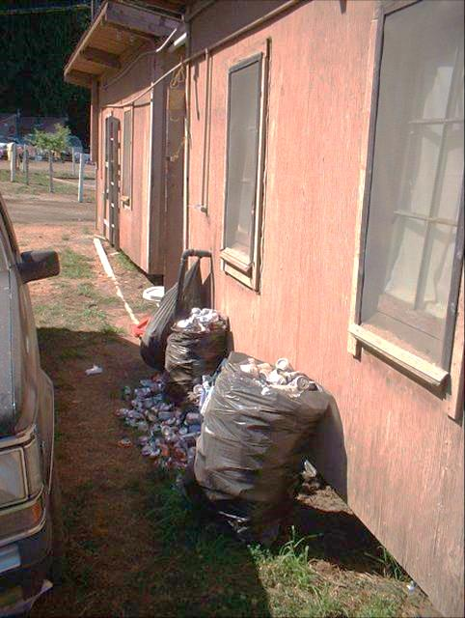
Many Children Grew up in
Families Facing Challenges
Crowded homes | 49%
Rodents | 32%
Food Insecurity | 50%
No blocks or stacking toys (12m) | 51%
Bradman et al., 2005 EHP
Photo by Seth Holmes

Slide 13
Stress and Children
When stress was higher, children had slightly lower development scores at 7 years.
In families with more stress, pesticides had a bigger affect on child development.
In families with less stress and a more positive learning environment, pesticides had had a lower affect on child development.
Notes:
Verbal IQ at 7Y.
Controlling for maternal IQ score and language of neurological assessment
Positive learning environment includes: having stacking blocks, etc.

Slide 14
Use of OPs has also decreased!
Notes:
Note: Char needs clarification if this is monthly in CA or yearly in monetey county/salinas valley

Slide 15
Chemicals and Chances of Being Overweight

Slide 16
Background
Many youth in the U.S. are overweight.
Good food and exercise are important to our health.
It can be hard to get healthy foods, cook fresh meals, or find the time or place to exercise.
Scientists are wondering if chemicals in the environment increase chances of becoming overweight.

Slide 17
CHAMACOS Findings
12 year olds were likely to be overweight if more of certain chemicals found in some plastics and personal care products were higher during pregnancy.
Mothers with higher levels of DDT, an old pesticide no longer used, or certain flame-retardants were also more likely to have boys that weighed more (but not girls).
We are trying to learn more about chemicals and weight in people.
Notes:
Phthalates: often in perfume, shower curtains, and floor tiles
Flame Retardants: often found in upholstered furniture

Slide 18
We are doing more research on
Flame retardant exposure and puberty
Chemicals from plastics and overweight
Neighborhoods, stress, and development
How our body reacts to stress

Slide 19
Future Directions…
Birth
1 yr
3 ½ yr
7 yr
10 ½ yr
Pregnancy
6 mo
2 yr
5 yr
9 yr
12 yr
16-21 years
We want to learn more about how chemical exposures might affect health at older ages and also figure out what we can do to make sure our children can grow up healthy. We hope to follow your children up to 21 years!

Slide 20
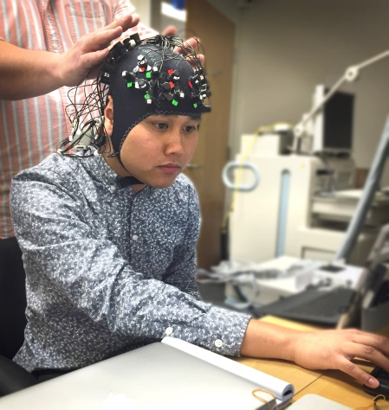
18- Year Visits
CHAMACOS is known all over the world as such an important study because we followed your children for so long. Thank you for staying with us!
We will soon start an exciting new project allowing us to see how a person’s brain reacts as they perform different thinking tasks for 18-year visit. They will wear a hat with special sensors that show us which parts of the brain are being used to complete certain tasks.
Your child may be asked to wear a cap with sensors on it while they perform tests on a computer. The cap looks complicated, but it is totally safe. Its even used on newborns.
Notes:
Don’t worry: it isn’t dangerous– it’s even used in research with newborns!

Slide 21
Tips for Staying Healthy
There is a lot we can do to keep healthy:
Eat healthy food
Get exercise
Sleep well
Read
Don’t smoke or abuse alcohol or drugs
Talk to friends/family when you need help
Spend time with your family
Notes:
Verbal IQ at 7Y.
Controlling for maternal IQ score and language of neurological assessment

Slide 22
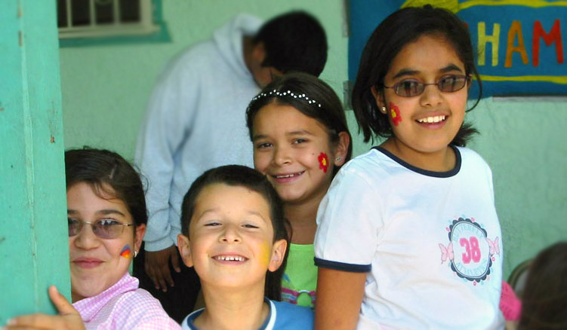

Slide 23
Advice for Parents of Adolescents
Be in the same space as your teen. Invite them to hang out nearby while you do chores. Even if you aren’t talking, your teen benefits from your presence and it might lead to improved trust or important conversations!
Monitor your teen’s screen time. Electronics should be used mostly for homework. Encourage your teen to not use screens before bedtime, they may reduce quality and amount of sleep.

Slide 24
Make sure your teen gets enough sleep! Teens who get 8-9 hours of sleep are more likely to have a positive mood, perform better in school, and be healthier in the long term.
Be involved in your teen’s school and activities as much as possible (ex. back to school night, read school emails/mail etc). Ask your child about their school experiences and show them that you care, even if you can’t always be there. Encourage them to volunteer, maybe even with CHAMACOS : )

Slide 25
Discussion and Questions
Role in community
Questions

Slide 26
CHAMACOS is on Facebook!
“Like” and “follow” us to learn the latest CHAMACOS news and to message us privately without phone charges!
www.facebook.com/CHAMACOS.CERCH/
(@CHAMACOS.CERCH)

Slide 27
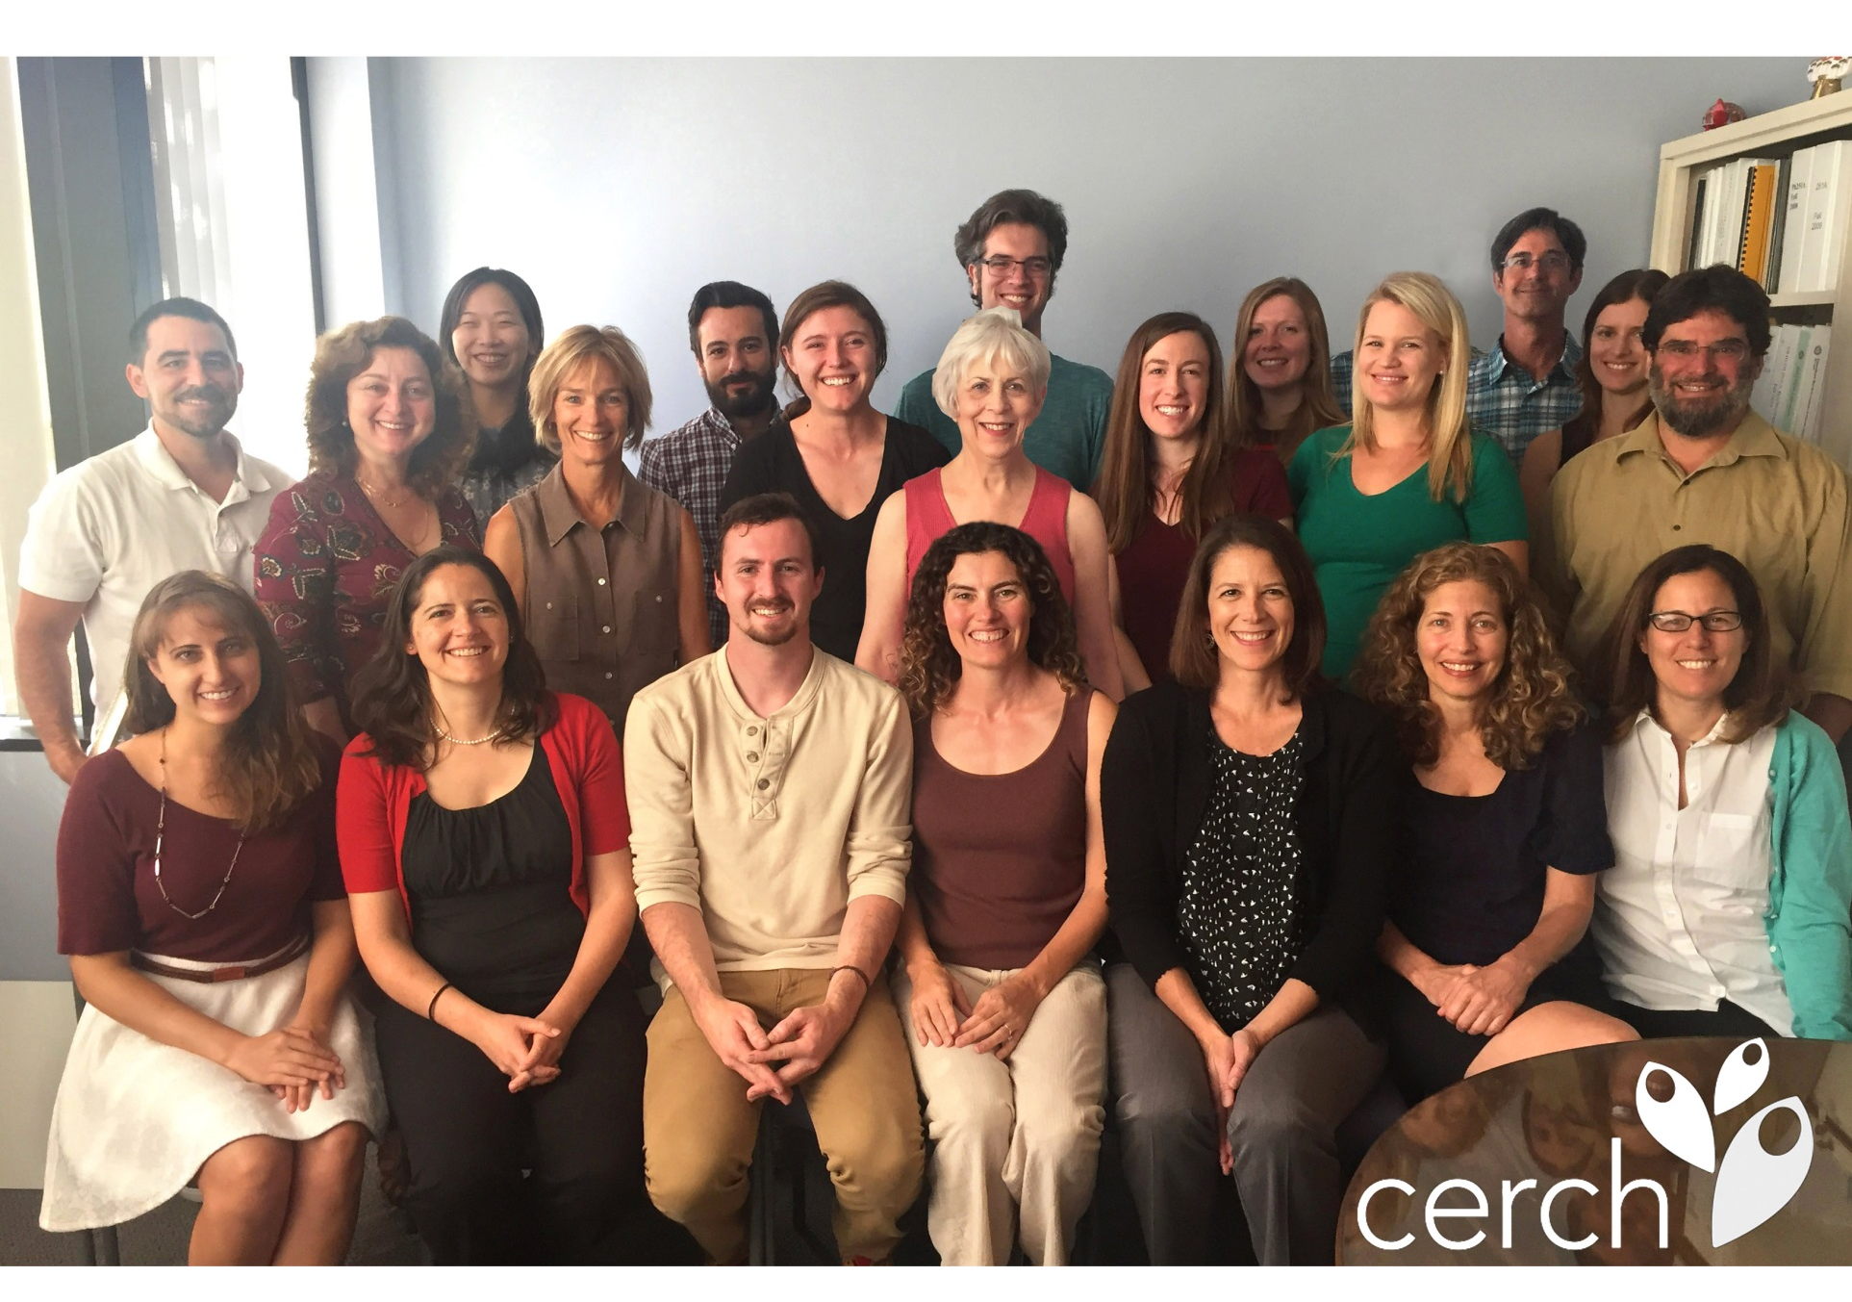
T h a n k Y o u !

Slide 28
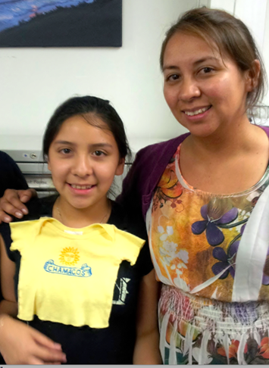
Very special thanks to the families who participate !
CHAMACOS Photo

Slide 29
Funders of CHAMACOS

Slide 30
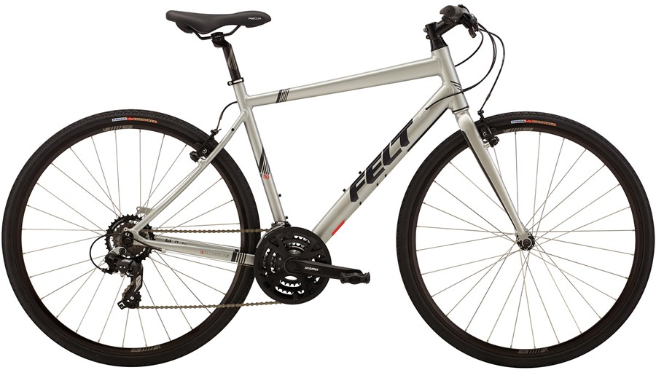
Special Thanks to Mike’s Bikes !
Sam Salzeider, manager of Mike’s Bikes Berkeley, donated a helmet and greatly reduced the price of a bike for our CHAMACOS Forum raffle this year!

Slide 31
CHAMACOS Website Page: http://cerch.berkeley.edu/research-programs/chamacos-study CHAMACOS Facebook Page: https://www.facebook.com/CHAMACOS.CERCH/ eNewsletter Sign-Up: http://oi.vresp.com/?fid=cee399448a
More findings and resources:

