Slide 1
Learning Your Chemical Results
Notes:
Community Forum 2015

Slide 2
The Long Wait
Research takes time
Needed blood samples from all CHAMACOS moms and kids
Sent samples to Atlanta to be analyzed
Permission
Committee at UC Berkeley
Notes:
Starting tonight, we have CHAMACOS mothers’ and children’s individual chemical exposure levels ready to share with you. The results are for chemicals measured in blood and urine collected when children were 9 years old. We know many families have wanted to learn their results for a long time. You may wonder “what’s taken so long??”
There have been two reasons for the long wait. The first has been research needs. We do these measurements for research and not for medical purposes. When your doctors measure something in you blood or urine, they do it as quickly as possible since the purpose is to find out if you have a health problem and to make it better. When we do measurements for research purposes, we have different concerns in mind. We prefer to do everyone’s measurements at the same time because it is more efficient, less expensive, and ensures that everyone’s samples are measured exactly the same way. In CHAMACOS, there is now a 2½ year age difference between the oldest CHAMACOS children and the youngest children. That means that even if we measured samples immediately upon finishing all age 9 visits, it would already have been 2½ years since the first samples were collected.
The second reason has been that, for a long time, we were not allowed to return your results to you. You may know that there is a committee at UC Berkeley whose job it is to protect your rights as research participants. It is their job to ensure that all the research activities we do are safe and appropriate, so that we do not cause you physical harm or emotional distress. Some members of this committee feel it is not right to return individual chemical results to families, because it may cause anxiety or distress. It took us several months of discussions with the committee to gain their approval. We believe that you have the right, as families, to decide whether or not to receive your results.

Slide 3
What will you learn?
Levels of 3 chemicals from you and your child.
DDTE
PBDE’s
PCB’s
The level of 1 additional chemical of your child.
BPA
The chemicals are NOT pesticides used in California
Notes:
I will be showing you the levels of certain chemicals from the environment that we measured in these samples. Before I do this, I want to remind you of a few things. First, it’s important to know that almost all people in the United States have these chemicals in their bodies, so it will be perfectly normal if we also found them in yours. Second, it’s important to remember that these results do not have any medical meaning. These chemicals are used because they are considered safe, and it is very unlikely that having them in your body will make you sick. However, scientists are still doing research to learn if these chemicals have any subtle effects on health or development; this is the reason for the CHAMACOS Study. We are providing you these results because we know many participants are curious to know their own levels and to learn ways to reduce exposure to these chemicals.
If you choose to receive your results, we will let you know for 3 to 4 different chemicals how your levels compare to other people in CHAMACOS and to other Americans in your age group. I will talk more about the specific chemicals in a few minutes. These chemicals are not locally-used pesticides. They are chemicals that people are exposed to in their homes, or that they may have been exposed to in Mexico. Your levels may be high, medium, or low compared to other people, but even if your levels are high, it is very unlikely that these chemicals will make you sick. Presently, there are no established “safe” or “unsafe” levels for these chemicals.
Families who have been CHAMACOS since birth will receive results for 4 chemicals, and families who joined at age 9 will receive results for 3 chemicals. This is because we only had enough funding to measure one of the chemicals in families that also had measurements from pregnancy.

Slide 4
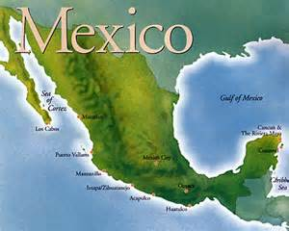
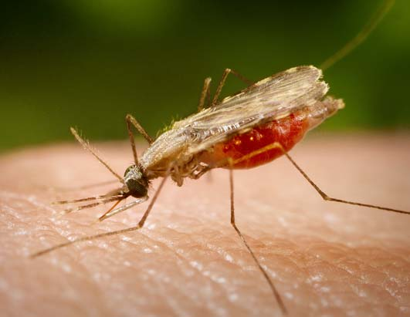
DDT and DDE
DDT is a pesticide used on U.S. farms until 1972.
It was used to control malaria in Mexico until 2000.
Notes:
DDT is a pesticide used to kill insects.
It was used on farm crops in the United States until 1972.
It was used to prevent malaria in Mexico until 2000.
It is no longer used in the U.S. or Mexico, but it can remain in the soil and in our bodies for many years.
DDE is formed as DDT breaks down in the environment, and is another marker for DDT exposure.
You will probably not experience new exposures to DDT unless you travel to countries in South America, Africa, or Asia where it is still used.
If DDT or DDE is measured in your blood, it is probably left over from past exposures.
Your levels will get lower naturally with time.

Slide 5
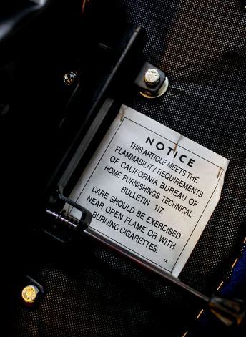
PBDEs
PBDEs are added to household items to stop fire.
Notes:
PBDEs are found in:
The foam in furniture, car seats, and baby products.
Carpet padding.
Electronics like TVs and computers.
Items purchased in California before 2005 are the most likely to have PBDEs.
To limit exposures,
Repair or replace upholstered items with ripped covers or exposed foam.
PBDEs get into house dust. Dusting with a damp cloth, wet mopping, and using a vacuum with a special HEPA filter can help.
Open your windows to let in fresh air.

Slide 6
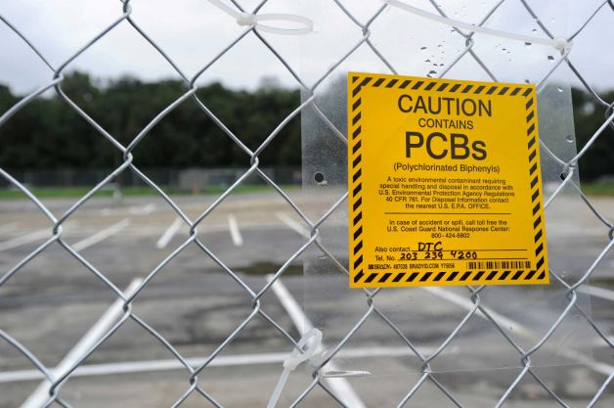
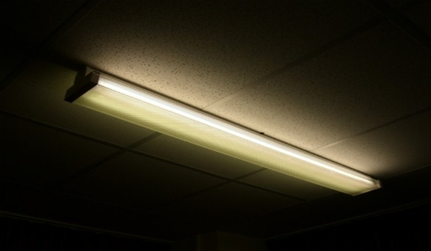
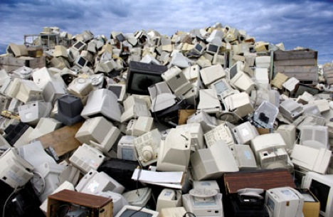
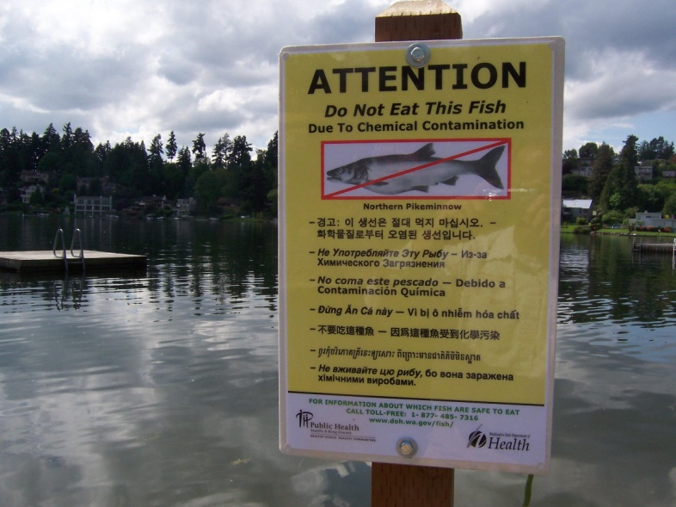
PCBs
PCBs were used in electronics until 1977, and now contaminate water and soil.
www.blogs.villagevoice.com
www.toxicfreenc.org
www.acountryfarmhouse.blogspot.com
Notes:
PCBs were used in electronics until 1977. Old electronics still pollute the air, soil, lakes, and oceans with PCBs. We are exposed to PCBs through:
Eating certain fish that come from polluted waters.
Indoor air in schools, homes, or offices that use old fluorescent lights.
To limit PCB exposure:
If you go fishing, follow local fish advisories. They will tell you if any fish are unsafe to eat.
If you live near a hazardous waste facility, do not let children play in the dirt.
Don’t allow children to put dirt in their mouths.
Wash children’s hands and faces often, especially before eating.

Slide 7
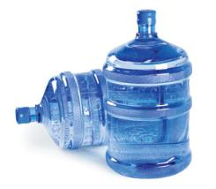
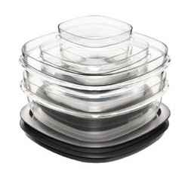
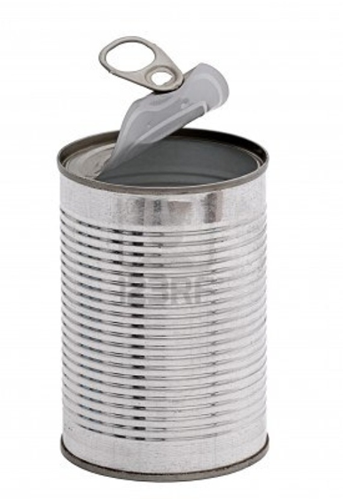
BPA
BPA is used in hard plastics, some food cans, and cash register receipts.
Notes:
BPA is a chemical that is used to make hard, clear plastics. It is found in:
Some hard plastic water bottles and food containers.
Canned foods.
Printed cash register receipts.
Hard plastics like CDs and DVDs.
To limit BPA exposure:
Use glass storage containers for food.
Use stainless steel water bottles.
If you must use plastic, look for items that are labeled BPA-free.
Avoid microwaving or heating foods in plastic bowls, cups or containers.
Eat fresh or frozen food instead of canned, if possible.
Wash your hands after touching store receipts.
(So far, we have only been able to measure BPA in urine from children who have participated in CHAMACOS since birth.)

Slide 8
Learn More in Your Packet
Learn more about each chemical:
What is it?
Can it affect health?
How can you prevent exposure?
Compare your levels with:
Other families of CHAMACOS
Other Americans
Notes:
Voy a estar mostrando los niveles de ciertas sustancias químicas del ambiente que medimos en estas muestras. Antes de hacer esto, quiero recordarles algunas cosas. En primer lugar, es importante saber que casi todas las personas en los Estados Unidos tienen estos productos químicos en sus cuerpos, por lo que será perfectamente normal si también las encontramos en el tuyo. En segundo lugar, es importante recordar que estos resultados no tienen ningún significado médico. Estos productos químicos se usan, ya que se consideran seguros, y es muy poco probable que tenerlos en su cuerpo van a causar que se enferme. Sin embargo, los científicos aún están haciendo la investigación para saber si estos productos químicos tienen efectos leves sobre la salud o el desarrollo; esta es la razón para el Estudio CHAMACOS. Estamos proporcionando a usted estos resultados porque sabemos que muchas de las participantes tienen curiosidad por conocer sus propios niveles y aprender formas de reducir la exposición a estos productos químicos.
Si decide recibir sus resultados, se los haremos saber por 3 a 4 diferentes productos químicos y sus niveles en comparación con otras personas en CHAMACOS y otros estadounidenses en su grupo de edad. Voy a hablar más sobre los productos químicos específicos en unos pocos minutos. Estos productos químicos no son pesticidas usados ​​localmente. Estos productos químicos son pesticidas que no se usaron ​​localmente. Son sustancias químicas a las cuales las personas están expuestas en sus hogares, o que pueden haber estado expuestas en México. Sus niveles pueden ser altos, medios o bajos en comparación con otras personas, pero incluso si sus niveles son altos, es muy poco probable que estos productos químicos pueden causar que usted se enferme. En la actualidad, no existen niveles “seguros” o “inseguros” establecidos para estos químicos.
Las familias que han estado con CHAMACOS desde su nacimiento recibirán los resultados de 4 químicos, y las familias que se unieron a los 9 años recibirán los resultados de 3 químicos. Esto se debe a que sólo teníamos fondos suficientes para medir uno de los productos químicos en las familias que también tenían medidas desde el embarazo.

Slide 9
What do these results mean for our health?
The results have no medical meaning.
No “safe or unsafe” levels are known
Most people have measurable levels in their bodies, but simply because we can measure them, this not mean that the chemicals affect your health.
CHAMACOS is one of the first studies in the world to investigate whether these risks affect human health.

Slide 10
Example 1: Maria’s PBDE Results
Let’s look at this black line and see what it tells us about Maria’s PBDE levels.
Notes:
The black line tells us that Maria’s PBDE levels are “Medium” values. Medium is another way to think about values or numbers that are right in the middle. This means that “medium” PBDE levels were measured in 50% (or half) of the CHAMACOS women. Another way to think about “medium” values is that Maria’s levels are not very high and they are not very low compared to other CHAMCOS women and women in the US.
Summary – should it say “Maria’s PBDE levels were about equal to…”?

Slide 11
Example 2: Arturo’s PBDE Results
Let’s look at where the black line is for Maria’s son, Arturo.
Notes:
What does Arturo’s black line tell us about his PDBE results? For Arturo, the black line is in the section for “High” values. This means that Arturo’s PBDE values are in the same group as the top 25% of PBDE values for children. Another way to think about it is that 1 out of every 4 children will have a PBDE value in the “High” section of the graph. What does having a “high” PBDE level mean for Arturo? What should he and Maria do? Do they need to go to the doctor? The important thing to remember is that having a PBDE level in the high section does not mean that something is wrong with Arturo or that he is sick. It just means that Maria and her family might want to take steps to reduce PBDE exposure??
(Note: It’s actually common for CHAMACOS children to have higher PBDE levels than their mothers, especially if their mothers spent part of their lives in Mexico. PBDE exposure levels are much higher in California where the children have been raised.)

Slide 12
Example 3: Gina’s PCB Results
Now let’s look at Gina‘s results and see what the location of Gina’s black line tells us about her PCB levels.
Notes:
Where is the line for Gina’s results? That’s right, Gina’s line is in the “low” section. This tells us that Gina’s results are in the low category of PCB values, with the 25% of women with the lowest value. What does this mean for Gina? Can she just forget about PCBs and other chemicals? We like for everyone to take a cautious approach to chemicals. That’s why we are hoping everyone will follow our advice for lowering exposure.

Slide 13
Consider: Do you want to know?
“Pro”s
You are curious!
Motivation to limit exposure
Possible relief if your levels are low or average
“Con”s
Possible anxiety if your levels are high
Take your time to decide – there is no rush
Notes:
Before you decide whether or not to receive your results, we would like you to think carefully about the pros and cons of knowing them.
One “pro” of knowing is that you are probably very curious. You will have information about yourself that very few other people are able to know. For example, most of us speaking to you today do not know our own levels – they’ve just never been measured. Another “pro” is that learning your own results may motivate you to limit your family’s exposure to these chemicals. Even though we still don’t know for certain whether these chemicals have effects on your health, we still think it’s a good idea to avoid chemical exposures when we can, and knowing your results may inspire you to do that. Also, if your levels are already low or average, it may be a relief to know this.
But there may be “con”s to knowing your results as well. One important “con” is that you may feel anxious or scared if you learn your levels are higher than other people’s. It may worry you that there are chemicals in your body that stay there for a long time, even when you limit new exposures, and it may bother you that you don’t know whether the chemicals have any health effects. It may help to remember that these are very normal exposures that nearly all Americans come in contact with, and that they are generally considered safe. However, if you think you will feel very distressed if your learn your levels are higher than other people’s, it may be the best choice for you not to receive them. If you choose not to receive them, you will be like most Americans who don’t know our own levels. You can still make choices to limit your family’s exposures.
In short, please think carefully about the right choice for you and your family. If you need time to think about it, that’s fine. Even if you decide not to receive them tonight, you can still get them from us in the future if you change your mind.

Slide 14
When can you learn?
Tonight
Line up by child birth month
Get your private results packet
Speak privately with staff or volunteer
Visit our educational tables on preventing exposure
If line is too long, please go to demonstration table on “how to reduce levels”
We will stay after the raffle to answer any questions. The demonstration will also remain open.
But we may not be able to answer everyone’s questions tonight…
Notes:
There are different ways to receive your results. If you choose to receive your results tonight, here is what will happen. When we finish this presentation, we will ask you to line up at the group for your child’s birthday. If your child was born between the months of January and June, you will line up at the January-June table. You will give your child’s date of birth and name to the person at the table, and they will give you a packet that contains your results. You may open it right away if you wish. We would like to offer everyone an opportunity to speak privately with a member of our staff or a volunteer who is trained to answer your questions. We have a set up a number of private meeting spaces where you can meet with someone. (Wave, people at these tables!) You may need to wait in line to speak to someone privately.
If you would like to get your results but don’t have time to stay and have questions answered, or if we don’t have the right packet available for you, you may write your name and phone number on a list of people who we will speak to on a different day. The list is with Andrea over there (wave, Andrea). Please indicate on this list if you would like to meet with us in person at the CHAMACOS office or by phone. If you prefer to speak by phone, it will be most convenient if you pick up your packet tonight. Otherwise we will need to mail it to you. If you will be coming to the office, you can decide whether you want to take your packet tonight or wait. Either way, please indicate on the list whether or not you already have your packet.
If you’re not sure whether you want your results, you don’t need to do anything tonight, but you are always welcome to call us at the CHAMACOS office if you decide you would like them.

Slide 15
If it's not tonight ...
Another day
Pick-up your packet tonight
We will call you in a couple of weeks to discuss the results by phone

Slide 16
Who can learn results?
CHAMACOS mothers
Can learn mother’s and child’s levels
Other CHAMACOS parents or guardians
Can learn child’s levels only
CHAMACOS children
Cannot learn results on their own
Must be with parent or guardian
Notes:
We are only able to return results to certain people. If you are a CHAMACOS mother, we are able to give you your own results and your child’s results. You can decide whether you’d like to receive them alone or whether you’d like other family members to join you.
If you are a father or other adult guardian of a CHAMACOS child, we are able to give you your child’s results only. We may need to print you a new results packet that only contains your child’s levels, and in this case you may need to wait and receive them another day. If this is your situation, you may check with us to see if we have a child-only packet available for you. (NOTE TO SELVES, NEED TO INDICATE ON ENVELOPE WHETHER IT CONTAINS MOTHER AND CHILD RESULTS, MOTHER ONLY RESULTS, OR CHILD ONLY RESULTS). You can decide whether you’d like to receive them alone, or whether you’d like other family members to join you.
We are not able to return results to children or youth on their own.

Slide 17
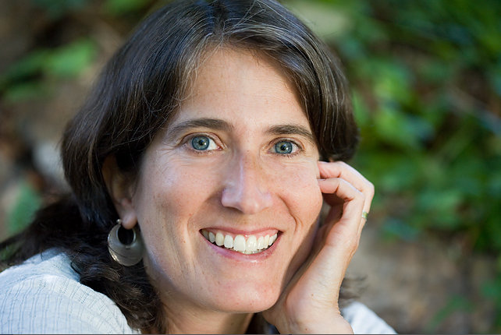
Another Opportunity
Dra. Rachel Morello-Frosch
Notes:
Finally, I’d like to introduce another UC Berkeley researcher who is here with us tonight. Dr. Rachel Morello-Frosch (wave!) would like to learn more about how people feel about learning the chemical levels in their bodies. For her research, she has interviewed people in a number of studies who have received their individual results, and she is interested in the experience of CHAMACOS families who learn their results. Dr. Rachel and her assistants may speak to you tonight and ask if you’d like to be interviewed. Her interviews are much shorter than CHAMACOS ones, and would take about 20 minutes of your time.

Slide 18
Questions?
Notes:
Does anyone have any general questions we can answer now? If not, you may start lining up to receive your results….

